Slide 1
Unit-3C SSR Conceptual Data Modeling

Slide 2
Conceptual Data Modeling
Representation of organizational data
Purpose is to show rules about the meaning and interrelationships among data
Entity-Relationship (E-R) diagrams are commonly used to show how data are organized
Main goal of conceptual data modeling is to create accurate E-R diagrams
Methods such as interviewing, questionnaires, and JAD are used to collect information
Consistency must be maintained among process flow, decision logic, and data modeling descriptions

Slide 3
The Process of Conceptual Data Modeling
First step is to develop a data model for the system being replaced
Next, a new conceptual data model is built that includes all the requirements of the new system
In the design stage, the conceptual data model is translated into a physical design
Project repository links all design and data modeling steps performed during SDLC

Slide 4
Deliverables and Outcome
Primary deliverable is the entity-relationship diagram, or ERD
There may be as many as 4 ERDs produced and analyzed during conceptual data modeling
Covers just data needed in the project’s application
An E-R diagram for system being replaced
An E-R diagram for the whole database from which the new application’s data are extracted
An E-R diagram for the whole database from which data for the application system being replaced are drawn

Slide 5
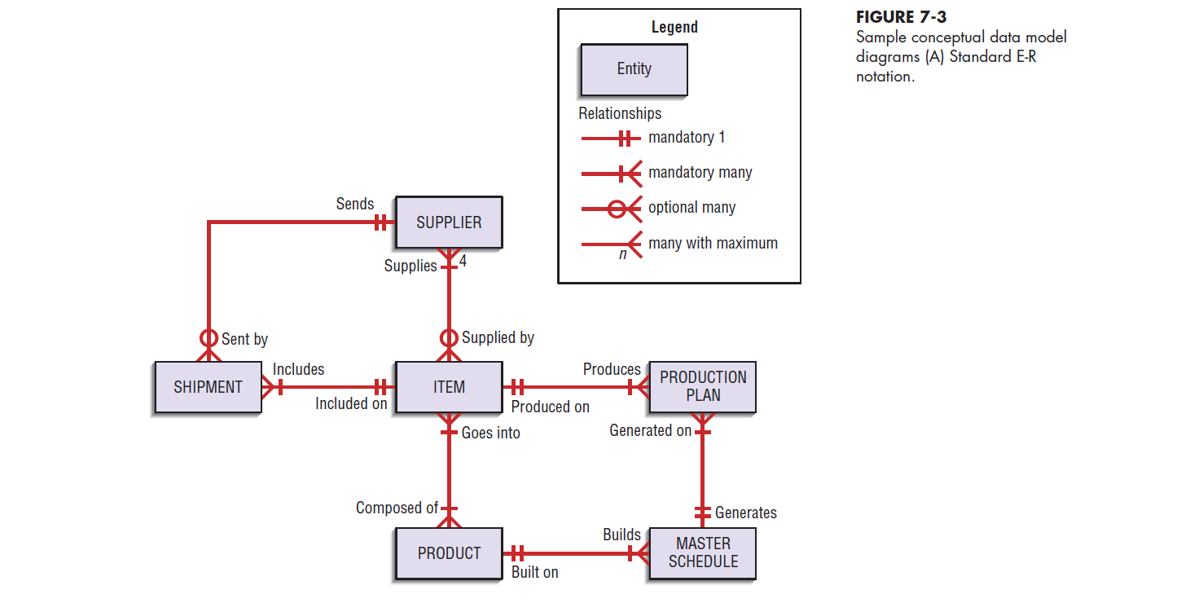

Slide 6
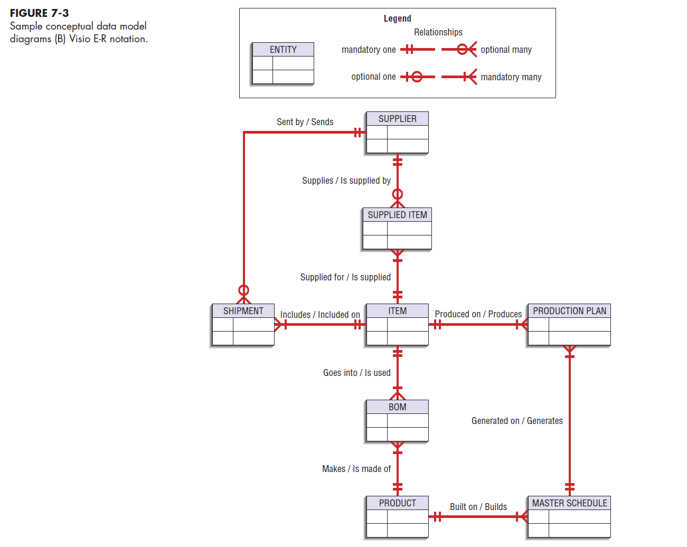

Slide 7
Deliverables and Outcome
Second deliverable is a set of entries about data objects to be stored in repository or project dictionary
Data elements that are included in the DFD must appear in the data model and conversely
Each data store in a process model must relate to business objects represented in the data model

Slide 8
Gathering Information for Conceptual Data Modeling
Two Perspectives:
Top-down
Data model is derived from an intimate understanding of the business
Bottom-up
Data model is derived by reviewing specifications and business documents

Slide 9
Introduction to Entity-Relationship Modeling
Notation uses three main constructs
Data entities
Relationships
Attributes
Entity-Relationship (E-R) Diagram
A detailed, logical, and graphical representation of the entities, associations and data elements for an organization or business

Slide 10
Entity-Relationship (E-R) Modeling Key Terms
Entity
A person, place, object, event or concept in the user environment about which the organization wishes to maintain data
Represented by a rectangle in E-R diagrams
Entity Type
A collection of entities that share common properties or characteristics
Entity Instance
Single occurrence of an entity type

Slide 11
Entity-Relationship (E-R) Modeling (continued) Key Terms
Attribute
A named property or characteristic of an entity that is of interest to an organization
Candidate Keys & Identifiers (primary key)
Each entity type must have an attribute or set of attributes that distinguishes one instance from other instances of the same type
Candidate key
Attribute (or combination of attributes) that uniquely identifies each instance of an entity type

Slide 13
Entity-Relationship (E-R) Modeling (continued) Key Terms
Identifier
A candidate key that has been selected as the unique identifying characteristic for an entity type
Selection rules for an identifier
Choose a candidate key that will not change its value
Choose a candidate key that will never be null
Avoid using intelligent keys
Consider substituting single value surrogate keys for large composite keys

Slide 14
Entity-Relationship (E-R) Modeling(continued) Key Terms
Multivalued Attribute
An attribute that may take on more than one value for each entity instance
Represented on E-R diagram in two ways:
double-lined ellipse
weak entity

Slide 15
Entity-Relationship (E-R) Modeling (continued) Key Terms
Relationship
An association between the instances of one or more entity types that is of interest to the organization
Association indicates that an event has occurred or that there is a natural link between entity types
Relationships are always labeled with verb phrases

Slide 16
Conceptual Data Modeling and the E-R Diagram
Goal
Capture as much of the meaning of the data as possible
Result
A better design that is easier to maintain

Slide 17
Degree of Relationship
Degree
Number of entity types that participate in a relationship
Three Cases:
Unary
A relationship between the instances of one entity type
Binary
A relationship between the instances of two entity types
Ternary
A simultaneous relationship among the instances of three entity types
Not the same as three binary relationships

Slide 18
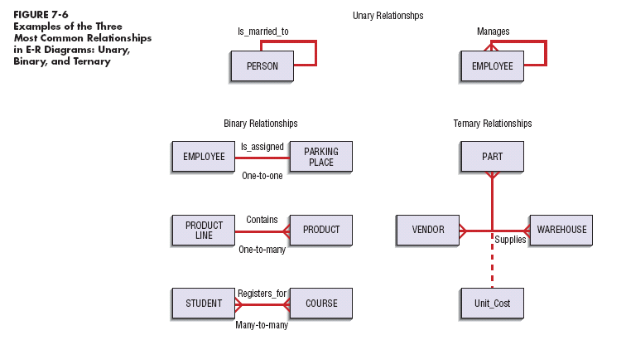

Slide 19
Cardinality
The number of instances of entity B that can be associated with each instance of entity A
Minimum Cardinality
The minimum number of instances of entity B that may be associated with each instance of entity A
Maximum Cardinality
The maximum number of instances of entity B that may be associated with each instance of entity A

Slide 20
Associative Entity
An entity type that associates the instances of one or more entity types and contains attributes that are peculiar to the relationship between those entity instances

Slide 22
PVF WebStore: Conceptual Data Modeling
Conceptual data modeling for Internet applications is no different than the process followed for other types of applications
Pine Valley Furniture WebStore
Four entity types defined
Customer
Inventory
Order
Shopping cart

Slide 23
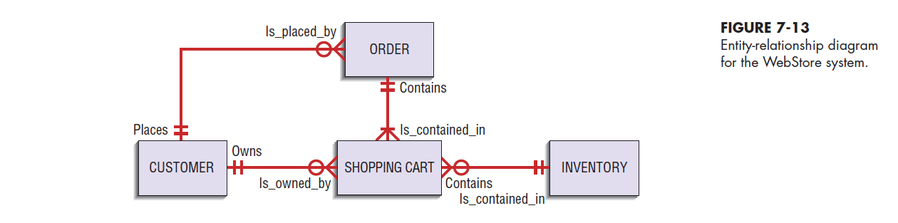

Slide 24
Key data-modeling terms
Conceptual data model
Entity-Relationship (E-R) diagram
Entity type
Entity instance
Attribute
Candidate key
Multivalued attributes
Relationship
Degree
Cardinality
Associative entity
7.2

